Slide 1
Flagging potential vehicle insurance frauds using ML
Made by:
David Naumovski 100/2022
Mihajlo Naumoski 101/2022
Mentor:
Prof. Dr. Hristijan Gjoreski /2022
Notes:
Source: https://www.templateswise.com/machine-learning-powerpoint-template/

Slide 2
Motivation
Vehicle insurance fraud poses a significant challenge to the insurance industry, leading to substantial financial losses and increased premiums for honest policyholders. Fraudulent activities, ranging from staged accidents to exaggerated claims, not only strain company resources but also erode customer trust. Traditional detection methods often fall short in identifying sophisticated fraud schemes, highlighting the need for advanced, data-driven solutions.

Slide 3
Analyzing the problem
The primary challenge lies in accurately detecting fraudulent vehicle insurance claims amidst vast amounts of data. Manual reviews are time-consuming and prone to human error, while rule-based systems lack adaptability to evolving fraud patterns. Implementing machine learning models offers a promising approach to predict and identify fraudulent claims efficiently, thereby safeguarding company assets and maintaining customer confidence.

Slide 4
Work phases
EDA
Preproccessing
Model training and selection

Slide 5
Dataset Overview
The dataset contains thousands of insurance claim records from
a vehicle insurance company, used to detect fraudulent claims.
Key Features:
Claims: Type of claim, accident details.
Vehicles: Vehicle age, make, and category.
Policyholders: Age, gender, marital status, and policy details.
Target Variable:
FraudFound_P – binary value: (1) fraud and (0) no fraud

Slide 6
Exploratory Data Analysis (EDA)
Class Imbalance: Fraudulent claims are significantly fewer than legitimate ones.
Feature Distributions:
Certain categorical variables like vehicle make and accident area show notable differences between fraud and non-fraud cases.
Numerical features like driver rating showed a pretty uniform distribution among the target class.

Slide 7
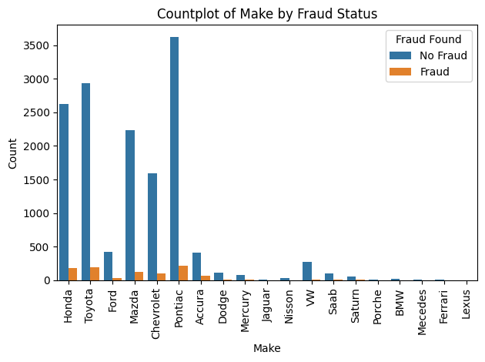
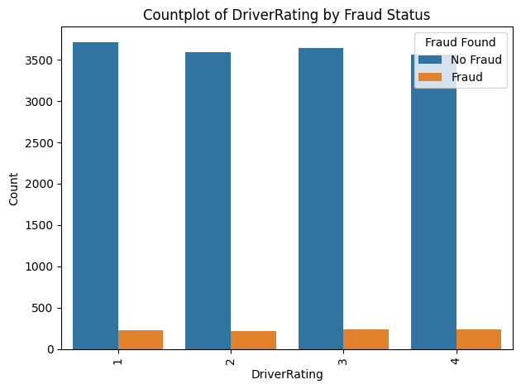

Slide 8
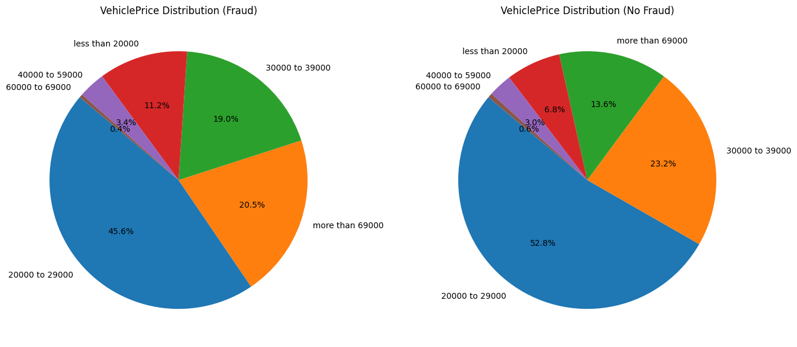

Slide 9
Data Preprocessing
Feature Selection:
Removed identifier columns (e.g., policy number) and redundant variables that add no predictive value.
Missing Values:
No missing values were found in the dataset
Encoding:
Applied one-hot, label and ordinal encoding on categorical features.
Scaling:
Standardized or Normalized numerical features to ensure compatibility with distance-based algorithms like KNN and SVM.

Slide 10
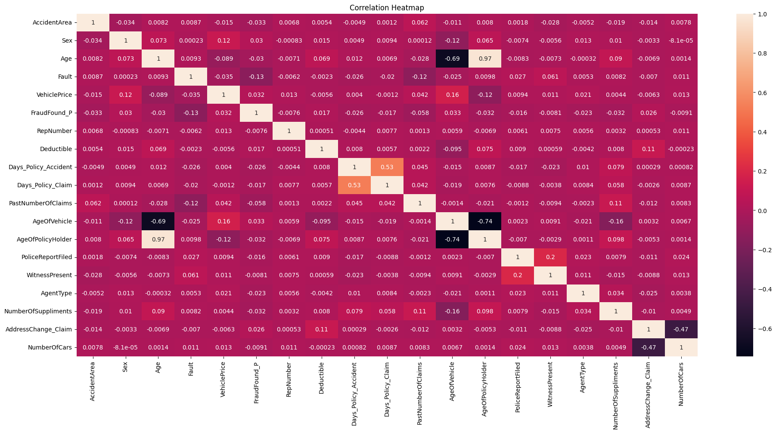

Slide 11
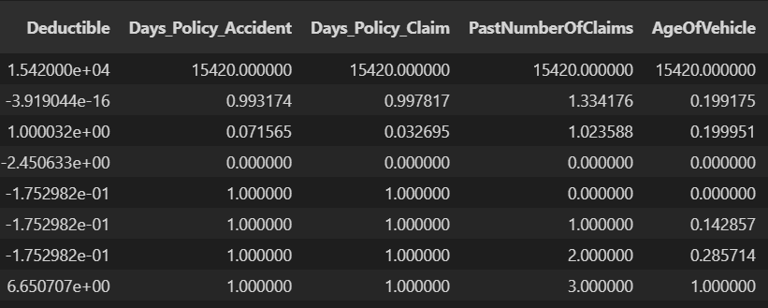

Slide 12
Class Balancing
Original Imbalance:
Fraudulent cases constituted a small fraction (often <10%) of the dataset.
Undersampling:
Balanced the dataset by reducing the number of non-fraud cases to match fraud cases, preventing model bias toward the majority class.

Slide 13
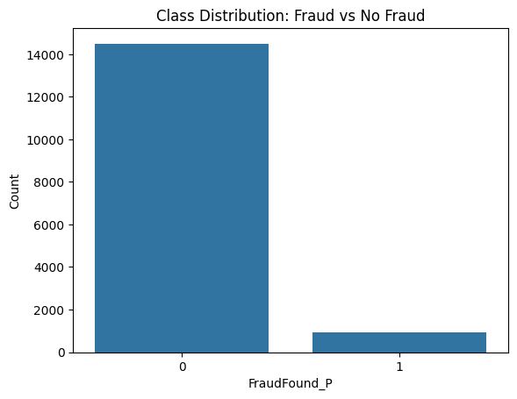
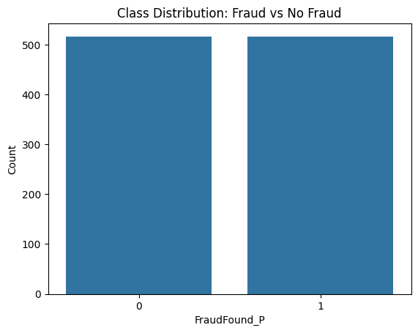

Slide 14
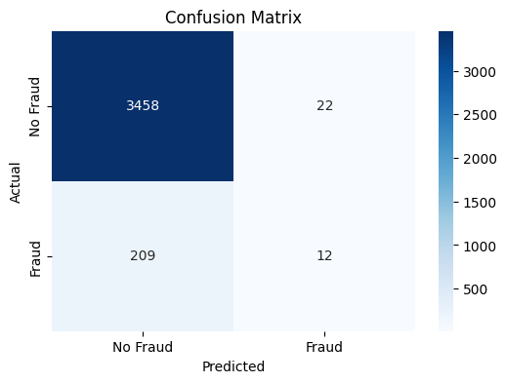
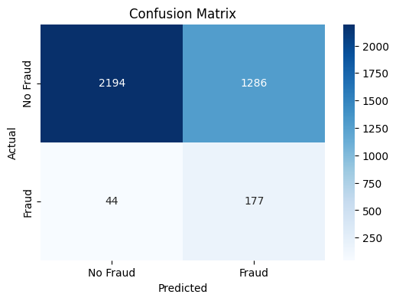

Slide 15
Model Selection & Training
Compared Algorithms:
Decision Tree, K-Nearest Neighbors (KNN), Support Vector Machine (SVM), Random Forest (RF), and XGBoost.
Why SVM, RF, XGBoost for Tuning:
These models showed promising initial results, strong generalization performance, and are known for handling tabular data and complex feature interactions.

Slide 16
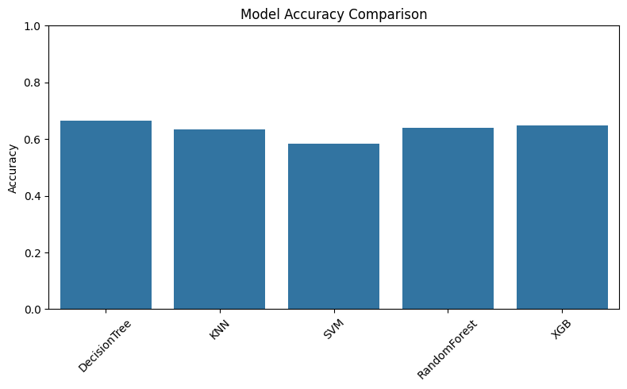
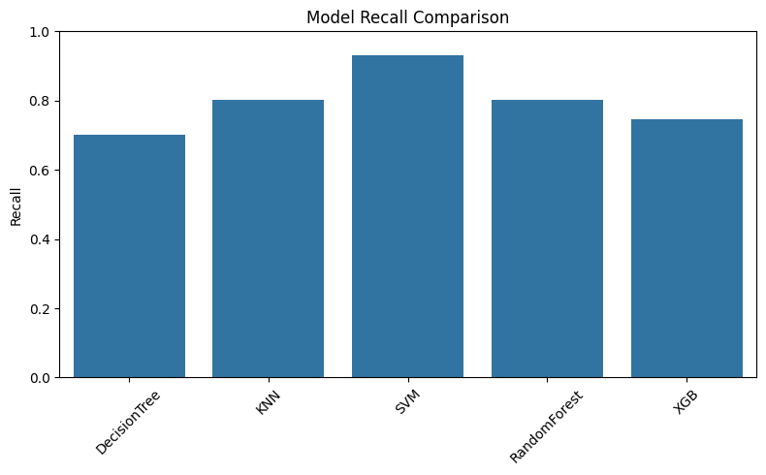

Slide 17
Model Optimization & Ensemble
Hyperparameter Tuning:
Used RandomizedSearchCV for efficient tuning over a wide parameter space.
Stacking Ensemble:
Combined the strengths of multiple classifiers into one meta-model, improving overall performance and reducing individual model weaknesses.

Slide 18
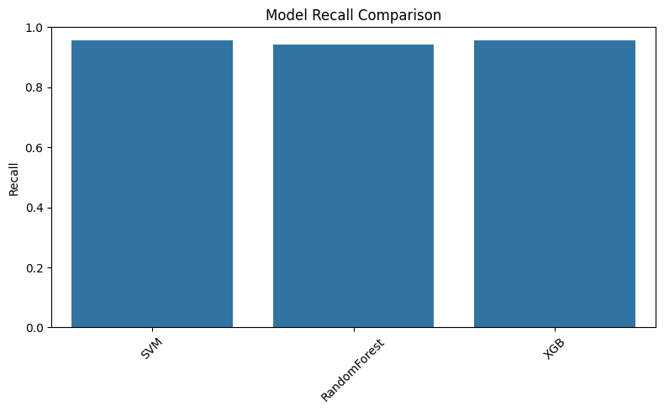

Slide 19
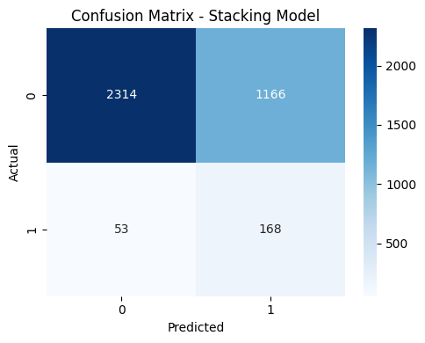
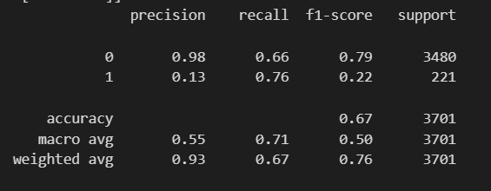

Slide 20
Results & Evaluation
Metrics Used:
Accuracy, Recall, F1-Score — with a focus on Recall to reduce false negatives (missed frauds).
Visuals:
Confusion Matrix and ROC Curves to visualize performance and trade-offs.
Best Model:
Depends on the resources and the goal of the insurance companies

Slide 21
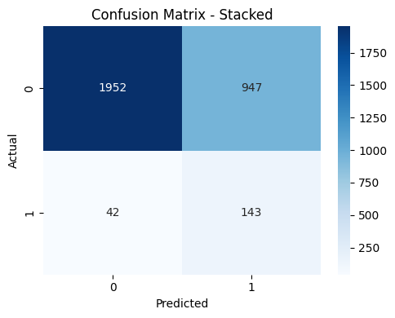
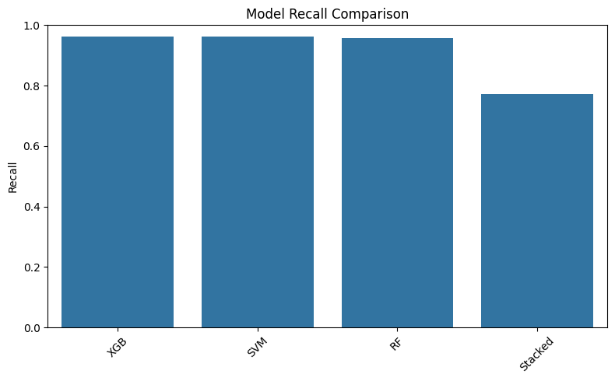
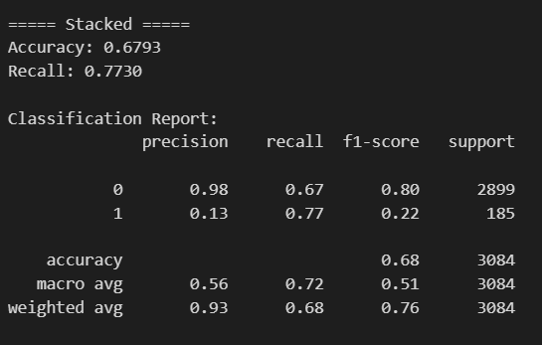
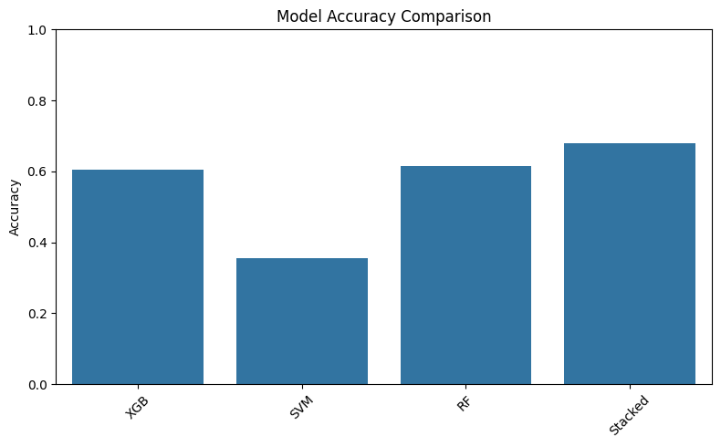

Slide 22
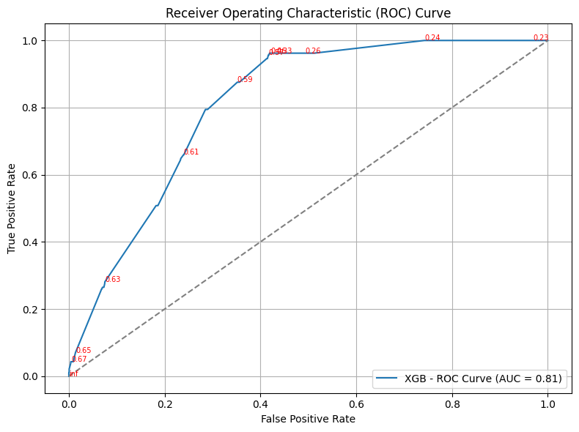
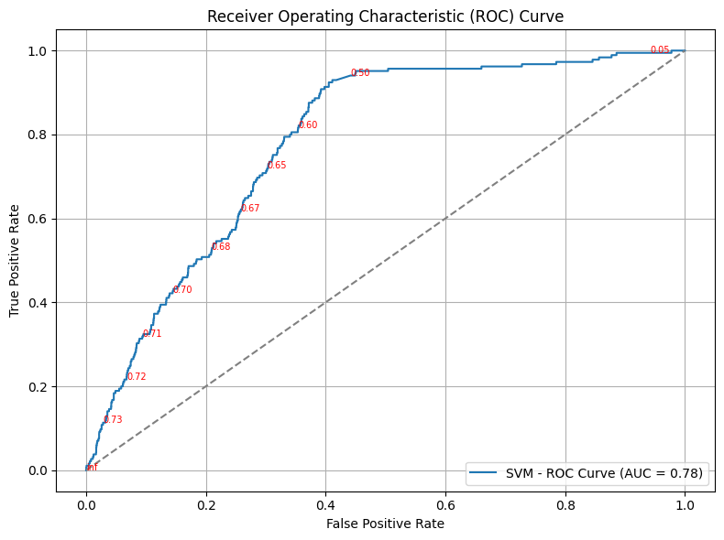

Slide 23
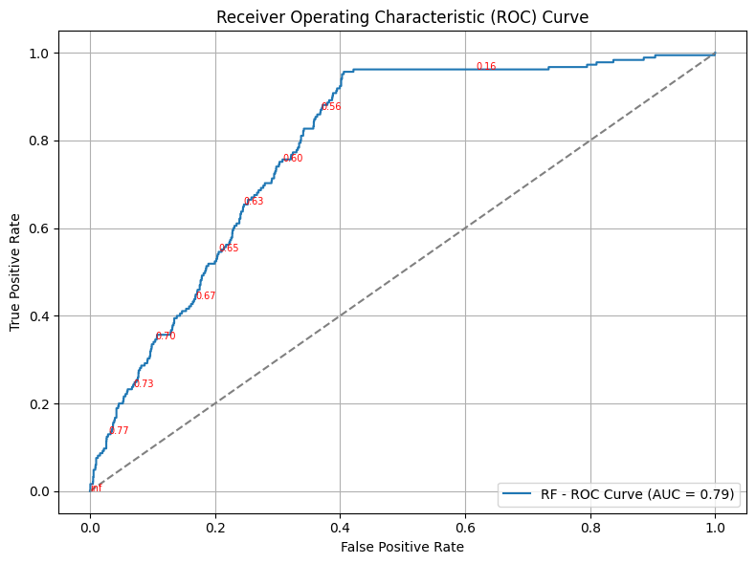
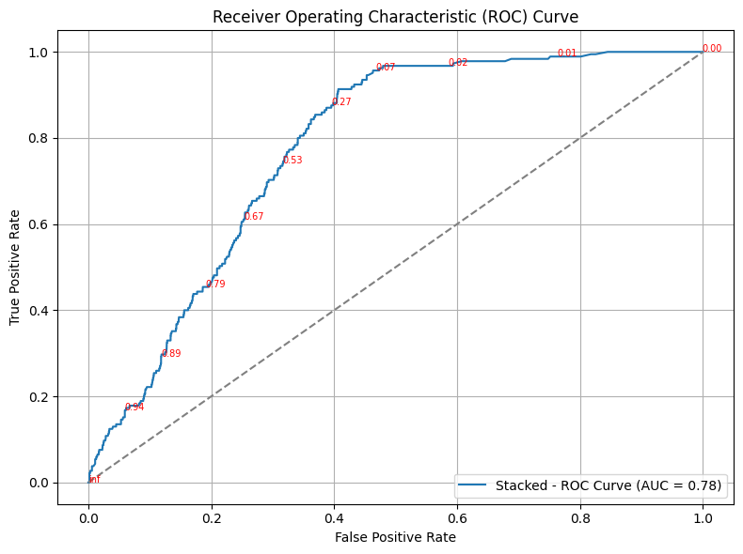

Slide 24
Conclusion & Future Work
Main Takeaway:
Machine learning models, especially ensemble methods, can effectively identify vehicle insurance fraud despite data imbalance.
Future Improvements:
Incorporate more domain-specific features (e.g., repair costs), gather data from different years and geographical locations,and deploy the model in a real-time detection pipeline.

Slide 25
QUESTIONS?

Slide 26

THANK YOU FOR YOUR ATTENTION
View notebook: vehicle-insurance-claim-fraud-detection-ML

